Slide 1
Post-Election Ally Skills Workshop
Using your societal advantages for good
Based on slides and materials developed by Val Aurora, CC BY-SA Frame Shift Consulting LLC.
All other materials, CC-BY-SA Kendra Albert.

Slide 2
Agenda for today:
Introduction to shared terminology
Empathy building strategy
“Normal” ally skills
Bystander intervention skills
Defensive people skills
Wrap-up
Notes:
Thanks to everyone for coming today.
We’re going to talk about post-election ally skills, which I divide into three categories (“normal ally skills” – what you would typically learn if you went to an ally skills workshop with me, bystander intervention skills - that’s skills for if you don’t know the people involved in a set of behaviors but feel like intervention is necessary, and “defensive people skills”, which is some strategies for dealing with one-on-one or small group conversations where you’re aiming to change hearts and minds.
I want to note before we start that a lot of the ally skills workshop formula is about getting people to a place where they feel comfortable intervening. This is a little different, in that many of the strategies that we talk about can be higher risk, or involve pushing your limits more.
Therefore, I want to start by saying that this is about skill-building, but if you don’t feel comfortable using these techniques, or feel like you’re not an ally in the situation and are not in a place to do so (you don’t want to build empathy with people who want to put you in electroshock therapy for being gay, THAT IS FINE.)

Slide 3
Who am I?
Out non-binary person (they/them please!).
“Day job” as a technology lawyer
Trans and feminist activist
Since 11/9, matched trans folks for $70,000 in documentation fees

Slide 4
What is an ally? Some terminology first:
Privilege: an unearned advantage given by society to some people but not all
Oppression: systemic, pervasive inequality that is present throughout society, that benefits people with more privilege and harms those with fewer privileges

Slide 5
What is an ally? Some terminology first:
Target: someone who suffers from oppression (also called "a member of a marginalized group")
Ally: a member of a social group that enjoys some privilege that is working to end oppression and understand their own privilege
Actions

Slide 6
Example
Privilege: The ability to walk into a convenience store and have the owner assume you are there to buy things and not steal them
Oppression: The self-reinforcing system of stories, TV, news coverage, and legal system stereotyping Black people as criminals, that benefits non-Black people and harms Black people
Notes:
Let’s do a quick example. Here’s an example of a privilege some of you may not even realize you have. (Read slide) Note how the ally is defined by their actions.

Slide 7
Example
Target: Any Black person who wants to enter a convenience store
Ally: A non-Black person who donates to legal system reform organizations, actively objects to racist stories, votes in anti-racist ways, and reads news articles about this privilege
Notes:
Let’s do a quick example. Here’s an example of a privilege some of you may not even realize you have. (Read slide) Note how the ally is defined by their actions.

Slide 8
Can you act as an ally? Categories of privilege:
White Male Cisgender (more later) Straight Not disabled A legal resident or citizen Specific ages Certain height/size/shape | Not a mother Not a caregiver Educated Technically experienced Wealthy (can be earned) From an upper class family And many more...
Notes:
Don't read the obvious ones, just the ones that are more relevant or less obvious

Slide 9
Why should allies take action more than targets?
"[...] Ethnic minority or female leaders who engage in diversity-valuing behavior are penalized with worse performance ratings; whereas [ethnic majority] or male leaders who engage in diversity-valuing behavior are not penalized for doing so."
David Hekman, Stefanie Johnson, Wei Yang & Maw Der Foo, 2016
Does valuing diversity result in worse performance ratings for minority and female leaders? http://amj.aom.org/content/early/2016/03/03/amj.2014.0538.abstract
Notes:
Targets are more likely to suffer retaliation when they speak out against oppression. This great study from 2014 looked at what happened to men vs. women and people of color vs white people when they did what they called "engage in diversity-valuing behavior." Listen to this quote: (Read slide)

Slide 10

More reasons allies should act more often
Allies have more power, influence, money, and energy
Allies may be in the majority
Allies can't be accused of jealousy
Allies are often less likely to be put in physical danger
CC BY Nick https://flic.kr/p/5bt6cp

Slide 11
Format of the rest of the workshop
Some terminology
Empathy exercise
Discussion guidelines
Ally Skills basics + scenarios
Bystander intervention basics + scenarios
Dealing with defensive people + scenarios
Wrap-up

Slide 12
What if I make a mistake?
Apologize, correct yourself, and move on.

Slide 13
Terminology: gender
Cis: your gender is the same as the gender that was assigned to you at birth
Trans: your gender is different than the gender that was assigned to you at birth
Non-binary or genderqueer or agender: "male" or "female" doesn't describe your gender accurately, or you don’t identify with a gender at all

Slide 14
Terminology: gender
Use they instead of "he" for third person singular pronoun of unknown gender (used by Austen, Defoe, Byron, Ronald Reagan...)
Terms for groups of people of particular genders: men for cis and trans men, women for cis and trans women, non-binary people/folks, cis men, trans men, cis women, trans women, people of all genders, folks, people, everyone, all, y'all, all y'all...

Slide 15
Please don’t use:
Girls for women 18 years of age and over.
Guys for groups that are not all men (say "everyone" or "people").
Ladies - associated with "proper" (i.e., subservient) behavior.
Females for humans - used for animals and plants too, so it is dehumanizing.
Notes:
http://i.imgur.com/0YoRYLK.jpg

Slide 16
Please don’t use:
Transsexual - not inclusive of all trans people
People with [BODY PART or CHROMOSOME] instead of "men" or "women"
Exception: members of any marginalized group can agree to call themselves whatever they want (outsiders should not assume they can use the same terms)

Slide 17
Terminology: sexuality
Straight for women attracted primarily to men or men attracted primarily to women
Gay for men or women attracted primarily to people of the same gender as themselves
Lesbian for women attracted primarily to women

Slide 18
Terminology: sexuality
Bisexual or pansexual for people attracted to people of any gender (debate on-going)
Asexual for people with little or no sexual attraction to people of any gender
Queer is a useful catch-all term for people who don't fit easily into "straight cis woman" or "straight cis man"

Slide 19
Discussion guidelines for race and ethnic group
Use the term(s) for each ethnic group or race that the majority of that group prefers that outsiders use.
Avoid abbreviations - just say or write the full name.
Don’t make generalizations about food, jobs, religion, citizenship, immigration status, languages, hobbies, etc. based on race.
Distinguish between citizenship and descent.
Notes:
https://commons.wikimedia.org/wiki/File%3ADog_ultrasound_whistle_ID_tag.jpg

Slide 20
Some commonly used terms for North Americans
People of color, white, Black, Latina/Latino/Latinx, Asian, Asian & Pacific Islander (API), south Asian, east Asian
Use specific tribe name if possible, otherwise:
Native Americans for indigenous peoples of mainland U.S.
First Nations for indigenous peoples of Canada
Native Hawaiians for indigenous peoples of Hawaii
Alaskan Natives for indigenous peoples of Alaska
Notes:
https://commons.wikimedia.org/wiki/File%3ADog_ultrasound_whistle_ID_tag.jpg

Slide 21
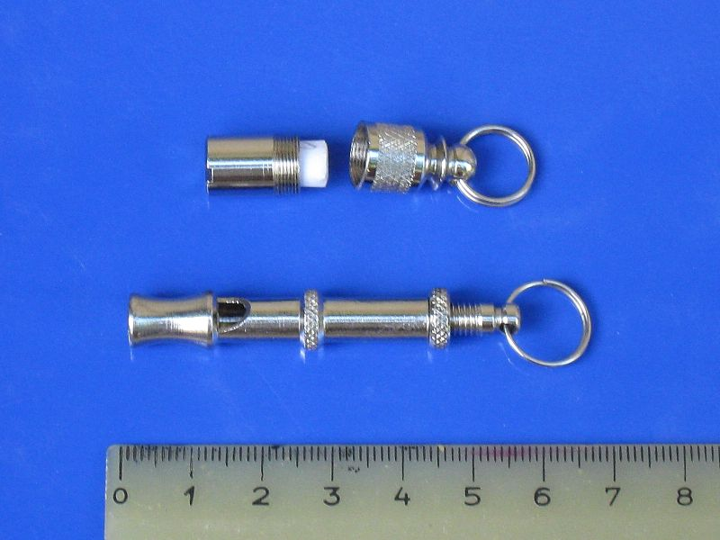
Discussion guidelines for race
Dog whistles: dogs can hear them but people can't
Don't use "dog whistle" terms to refer to an ethnic group indirectly - e.g., "ethnic" or "urban"
If uncertain about term to use to refer to a specific ethnic group, ask!
CC BY-SA Turbojet on Wikimedia Commons
Notes:
https://commons.wikimedia.org/wiki/File%3ADog_ultrasound_whistle_ID_tag.jpg

Slide 22
Discussion guidelines for disability
Use abled person, disabled person, or person with disabilities.
Don’t use names of specific disabilities as metaphors or similes to indicate badness (deaf, blind, etc.).
Don't use at all: lame, dumb, stupid, crazy, retard, etc.
Only use respectfully in cases of self-disclosure: ADD/ADHD, OCD, autism spectrum, schizophrenic, bipolar...

Slide 23
Discussion guidelines for disability
Instead use "foolish," "thoughtless," or "inconsiderate."
Or a specific adjective like "crowded," "disorganized," or "annoying."
It’s generally fine to use figures of speech like "see what I mean" or "I hear you."

Slide 24
Discussion guidelines for religion, class, age, etc.
Speak respectfully about religious or spiritual beliefs (but you don't need to be respectful of bigotry or intolerance)
https://en.wikipedia.org/wiki/Paradox_of_tolerance
Don’t use stereotypes about people with lower class jobs (e.g. janitor), adults of particular ages, family role (mother, grandparent, etc.)
Treat caregivers of all sorts respectfully, including mothers

Slide 25
Help us create a safer space
You may leave or return at any time, for any reason, without explanation.
This workshop is not recorded.
Everyone is here voluntarily.
Please anonymize when you repeat sensitive stories.
Share at the level of people you just met at a conference.

Slide 26
Awkward...

Slide 27
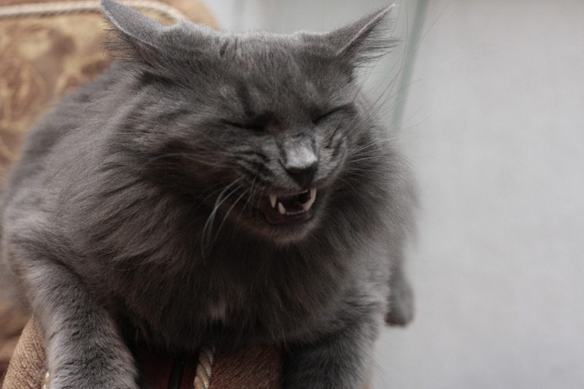
CC BY Andrew Kuznetzov https://flic.kr/p/4c8Sax

Slide 28
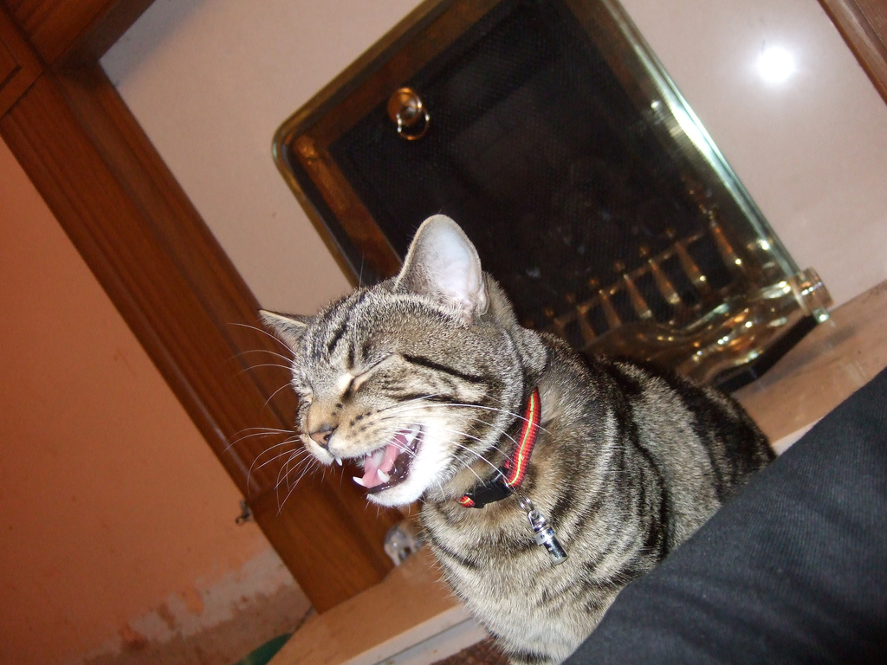
CC BY John of Wales https://flic.kr/p/HaeRd

Slide 29
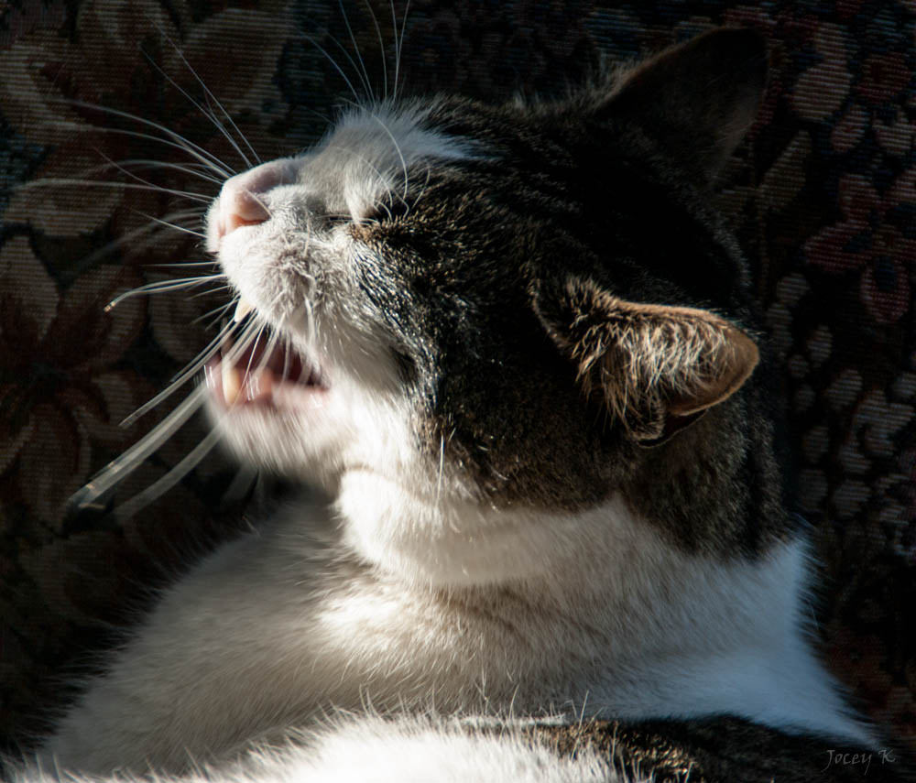
CC BY-SA Jocelyn Kinghorn https://flic.kr/p/jXHrXR

Slide 30
Content warnings
The scenarios contain discussions of: racism, Islamophobia, street harassment, discussion of undocumented people, misgendering/deadnaming, and police interactions with black people.
Note: neither the scenarios nor I will use specific slurs, but some may use uncomfortable language.
Absolutely do not speculate about what language might be used or reproduce slurs in the context of your answers.

Slide 31
Allies post-election: deploying empathy
Not all but some ally strategies rely on successful cultivation of empathy.
You may not be there right now! That’s okay.
Let’s talk about how to get there, if you want help.
Notes:
Huge amounts of debate about whether we need to have more empathy for Trump voters…my answer, for the moment, is that folks (especially people of color) need not suddenly develop empathy for people who don’t have empathy for them
However, I think that it is really important to evaluate how we make connections with other people who are not like us, if we have the energy.

Slide 32
Why and how to develop empathy?
“...Put simply, the broaden-and-build theory states that positive emotions widen people’s outlooks in ways that, little by little, reshape who they are.”
Fredrickson BL, Cohn MA, Coffey KA, Pek J, Finkel SM. Open Hearts Build Lives: Positive Emotions, Induced Through Loving-Kindness Meditation, Build Consequential Personal Resources. Journal of personality and social psychology. 2008;95(5):1045-1062. doi:10.1037/a0013262.

Slide 33
Exercise 1a: Developing empathy
Think of a person you’re close to. Think a kind thought about them.
“My partner is always so thoughtful in the morning, even when I’m cranky!”
“My child makes the cutest faces.”
“My friend always looks at the world in such a positive way.”
Notes:
(If this doesn’t feel right to you, feel free to just sit quietly instead of doing the exercise. )

Slide 34
Exercise 1b: Developing empathy
Pick five people in the room. Purposefully think a kind thought about each one of them.
Examples:
“Their haircut looks excellent on them.”
“That person has a kind face.”
“He has such excellent handwriting.”
“She did such a good job of making me feel welcome in the space.”

Slide 35
Exercise 1c: Developing empathy
Think of a person you had a negative interaction with this week. Think a kind thought about them.
“Although Sam pissed me off this week, they always are so good at organizing their work.”
Wish them well.
“I hope Sam has a good weekend.”
Notes:
My personal mantra: “It seems like that person is having a rough day. I hope it gets better for them.”

Slide 36
DREADED GROUP CHOOSING TIME
Form groups of 4 - 6 people.
Groups that are more diverse have better discussions.
Introduce yourselves BRIEFLY (1-3 sentences) and include your pronouns.
At the breaks, please volunteer to change groups.

Slide 37
Preparing for group discussion
If everyone in the group has the same pronouns, tell the instructor.
Choose a gatekeeper to interrupt people who are speaking too much and ask people who aren't talking as much if they want to speak.

Slide 38
A few more tips for group discussion
At the beginning of each scenario, choose someone to report out at the end (this person can change)
Avoid rules-lawyering: "But what if there was some specific highly unlikely circumstance in which this situation was not actually bad?"
Focus on how to respond to incidents as an ally in this specific incident, not as the target or in the general case

Slide 39
Basics of ally skills (responding to comments)
Be short, simple, firm.
Don't try to be funny.
Play for the audience.
Practice simple responses.
Pick your battles.

Slide 40
While you're trying to help one group, don't be:
sexist,
homophobic,
transphobic,
racist,
ableist,
classist,
ageist, and don't make fun of people for being sexually undesirable, unattractive, etc.

Slide 41
Scenario 1:
In an email thread, you refer to a trans man colleague using his preferred name and pronouns (he/him/his, in this case).
Another person replies using his previous name (a.k.a. “dead name”) and she/her/hers pronouns to refer to him. He is not on the thread.
Notes:
Goal response: Reply directly to thread clarifying that his name is his name and he uses he/him pronouns. Even if it’s totally accidental, correcting directly is important. If malicious, same first response, then escalate as necessary.
Someone in a workshop I ran once compared the appropriate tone to telling someone their fly was open.

Slide 42
Tips: pronouns dos and don’ts
Do: check in if you’re unsure about pronoun use or how to navigate a transition. To be clear, a person’s personal wishes override this list or any other advice.
Do: assume retroactivity unless told otherwise.
Do: use current preferred pronouns for famous trans people (like Chelsea Manning).
Absolutely don’t: ask about transition logistics or surgery.
Absolutely don’t: out the person.*
*Unless they’re already publically out or you’ve been given express permission.

Slide 43
Things to pay attention to
Who is speaking most in your group?
Is someone having difficulty being heard?
Are there patterns related to gender, race, age, or anything else?
How do these discussions compare to ones you have in other contexts?

Slide 44
Scenario 2: Addressing problematic behavior
You’re in an airport, waiting for your flight. A badged airport employee, wearing a headscarf, is pushing a man in a wheelchair to a nearby gate. She accidentally hits a garbage can with the side of the chair. The man in the chair calls her an Islamophobic slur. She seems to respond politely.
Notes:
Two different potential reactions here – one is to confront directly, another is to report to airport authorities/her employer
Can catch her eye, and mouth “sorry” or make a shocked look. Talk to a gate attendant
Write down her badge number and write to her employer to commend her bheavior
Forcing service worker direct intervention – not ideal

Slide 45
Break

Slide 46
Basics of bystander intervention (behavior)
Be aware.
Assess personal safety.
Focus on the target.
Consider five options: delay, delegate, distract, document, directly intervene
Based on the 4Ds of Bystander Intervention by Hollaback! https://www.ihollaback.org/responding-to-harassers/

Slide 47
Scenario 4: Addressing harassing behavior
You are on a public bus. A butch woman is sitting in the row across from you. A man behind her starts talking to her, but she ignores him.
He taps her on the shoulder, and she says something to him. He then begins swearing loudly at her.
Notes:
Distract either to the target or harasser.
“Hey man, what time is it?” “
Dudes greeting dudes.

Slide 48
Scenario 4: Addressing harassing behavior
Delay – apologize to the woman and say what happened wasn’t okay, offer to help after harasser has moved on.
Delegate – ask someone around you to do any of these things, go talk to the bus driver or transit authority.
Distract – go talk to the woman about something unrelated, like the time or the weather. Get her consent and then pretend to know her.
Document- start filming the interaction or take pictures of the harasser. (USE WITH CAUTION.)
Directly intervene – tell the man to knock it off, or otherwise engage him directly.
Notes:
These scenarios are hard because you can’t necessarily obtain consent from the target before action.
Default to distract if you want to intervene.
If intervening, see if you can move her away from the dude.

Slide 49
Scenario 5: Developing intervention skills
You are walking on the street in an area you frequent. There is a young black man who is being put in handcuffs in front of a nearby store. The two cops involved in the interaction are not paying attention to you.
Notes:
Do you have active warrants or are you at special risk if you have interactions with the police? If you’re trans or undocumented…higher risk.
Film the cops, as legal in your state. If not that, stay and watch. Use the ACLU app!

Slide 50
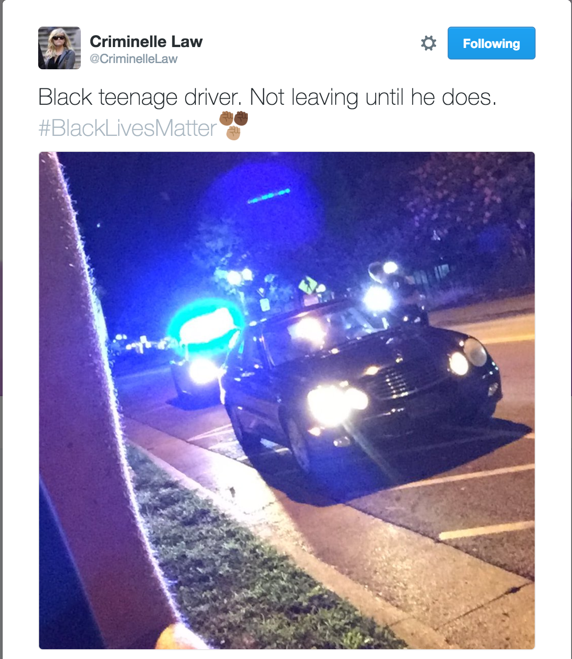
Notes:
https://www.aclu.org/other/know-your-rights-photographers?redirect=know-your-rights-photographers

Slide 51
Tip: if you don’t know what to do, learn
Ask yourself “What would it take for me to feel comfortable reacting to this situation in the future?”
Resolve to learn that information.
Google it!
Use guides produced by reputable organizations. The SPLC Stand Up guide is fantastic.
Notes:
https://www.aclu.org/other/know-your-rights-photographers?redirect=know-your-rights-photographers

Slide 52
Basics of dealing with defensive people
Invoke shared values.
Express compassion.
Make yourself vulnerable.
Share what changed your mind.
Help them have compassion.

Slide 53
Scenario 6: addressing harmful stereotypes
Your nephew, who you like a lot but don’t know well, is talking to just you at a small family event. He says something like “I don’t like Trump as a person, but I’m glad he will kick out illegals. At least our family came here legally.”
Notes:
Invoke shared values –
Express compassion
Make yourself vulnerable
Share what changed your mind
Help them have compassion

Slide 54
Tip: read Captain Awkward
Advice blog that answers questions on social interaction from an awkward, geeky perspective
Great for "How do I get someone to stop doing something without upsetting anyone?" type of questions (hint: someone is already upset)
http://captainawkward.com

Slide 55
Scenario 7: standing up for folks with concerns
You work at a tech company. You are part of a 10-15 person meeting on a new feature, that could be used to track users by particular characteristics without their specific consent.
A subordinate of yours expresses concern about how the Trump administration might use the data from the feature. A white male coworker of yours is very dismissive.
Notes:
Invoke shared values. – our company wants to value users
Express compassion – it’s scary to think about what
Make yourself vulnerable - this was also hard for me
Share what changed your mind – if we don’t do it, who will
Help them have compassion – we should do this thing

Slide 56
“Don’t you think they’re overreacting?”
Resist the impulse to validate this viewpoint.
Instead, concentrate on the validity of the experiences that lead people to be concerned about the rise of creeping fascism.
Notes:
Post-election, a lot of folks are going to want to believe that people (especially members of marginalized groups) are overreacting.
Just World
Privilege

Slide 57
Non-situational best practices
Don't expect praise and credit for fighting inequality.
Follow and support leaders from target groups.
Assume targets are knowledgeable about their oppression.
When you make a mistake, apologize, correct yourself, and move on.

Slide 58
This workshop is not a certification
Don’t be Kool Aid Man.
Ally is a thing you do (sometimes), not a thing that you are.
We will all continue to make mistakes, what counts is how you react.

Slide 59
Resources
Julie Pagano’s ”So You Want to Be An Ally” http://juliepagano.com/blog/2014/05/10/so-you-want-to-be-an-ally/ GLAAD’s “Tips for Allies of Transgender People” http://www.glaad.org/transgender/allies Mia McKenzie’s “The Difference Between Real Solidarity and Ally Theater” http://www.blackgirldangerous.org/2015/11/the-difference-between-real-solidarity-and-ally-theatre/
Val Aurora’s “Guest Post: A Post-Election Guide to Changing Hearts and Minds” https://captainawkward.com/2016/11/21/guest-post-a-post-election-guide-to-changing-hearts-and-minds/
SPLC’s “Speak Up! Responding to Everyday Bigotry” - https://www.splcenter.org/sites/default/files/d6_legacy_files/downloads/publication/splcspeak_up_handbook_0.pdf
Notes:
Add captain awkward: https://www.splcenter.org/20150126/speak-responding-everyday-bigotry
Splc: https://www.splcenter.org/20150126/speak-responding-everyday-bigotry

Slide 60
Questions and feedback
Thank you!
If you have questions that you feel are group appropriate, I’m happy to take them now. If you have questions you’d prefer to ask privately, talk to me after or email me directly at: kendra.serra@gmail.com I’ll send out an anonymous survey to folks who attended in a couple of days.

